Slide 1
Machine learning final project on
K-means
Pavankumar Pendela
811174790

Slide 2
Problem
Using an automobile data set to determine the car specification using a clustering model K-means
What is K-means
K-means clustering is a simple unsupervised learning algorithm that is used to solve clustering problems. It follows a simple procedure of classifying a given data set into a number of clusters

Slide 3
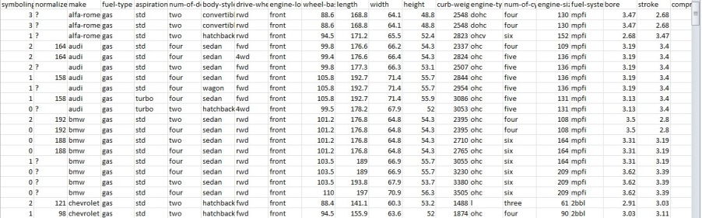
Dataset
https://www.kaggle.com/natigmamishov/eda-and-regression-on-automobile-dataset/data
The dataset has 205 rows and 26 columns

Slide 4
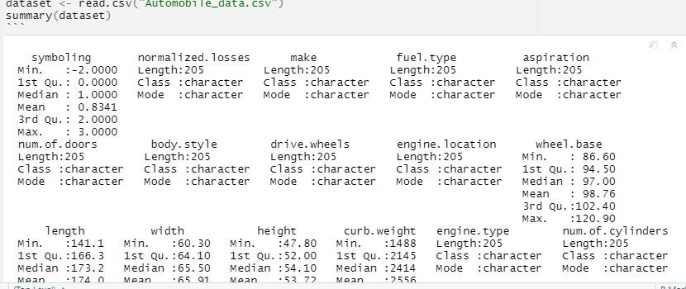
Goals and objectives
Import the data
Import the data
Data cleaning
Cluster Aanalysis

Slide 5
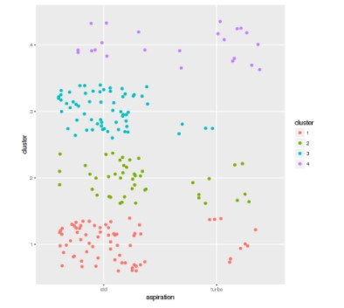
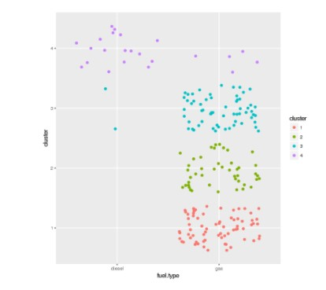
Clustering
Clustering by aspiration
Clustering by fuel type

